Slide 1
Deadlock Session 7
Course : COMP6153
Effective Period : September 2018

Slide 2
Sub Topics
Introduction to deadlock
Condition for deadlock
Strategies dealing with deadlock
Banker’s Algorithm

Slide 3
These slides have been adapted from: Stallings, W. (2011). Operating Systems: Internals and Design Principles. 8^{th.} ISBN: 978-0-13-380591-8 Chapter 6
Acknowledgement

Slide 4
Learning Objectives
At the end of this lecture, students are able to:
LO1 : Descriibe differen technques to prevent, avoid and handle deadlocks
LO2 : Explain the concept of deadock and methods for prevention, avoidance and detectiom
LO3 : Demonstrate how to prevent/avoid deadlock
LO4: Write Java program to Simulate deadlock

Slide 5
Introduction to deadlock (1)
Deadlock can be defined formally as follows:
A set of processes is deadlocked if each process in the set is waiting for an event that only another process in the set can cause.

Slide 6
Introduction to deadlock (2)
Permanent blocking of a set of processes that either compete for system resources or communicate with each other
No efficient solution
Involve conflicting needs for resources by two or more processes

Slide 7
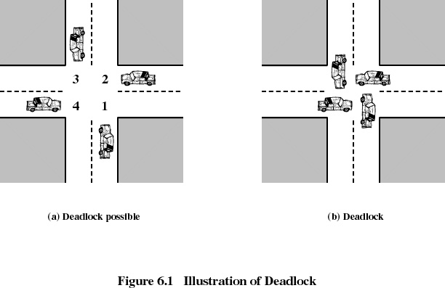
Introduction to deadlock (3)

Slide 8
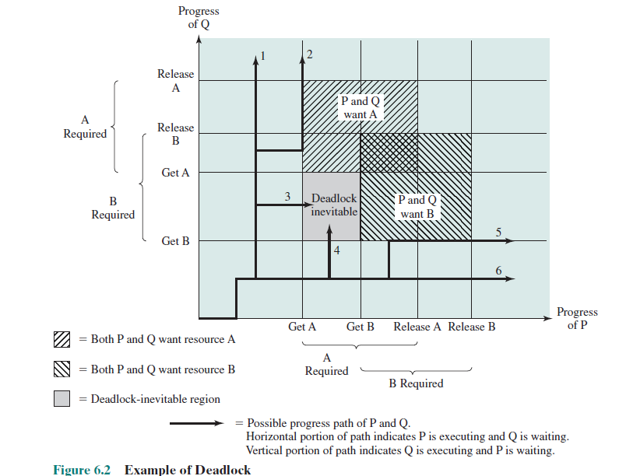
Deadlock example (1)
The joint progress diagram shows the progress of two processes competi for two resources
Each proces need eclusive use of both resources

Slide 9
Deadlock example (2)
Process P Process Q
• • • • • •
Get A Get B
• • • • • •
Get B Get A
• • • • • •
Release A Release B
• • • • • •
Release B Release A
• • • • • •

Slide 10
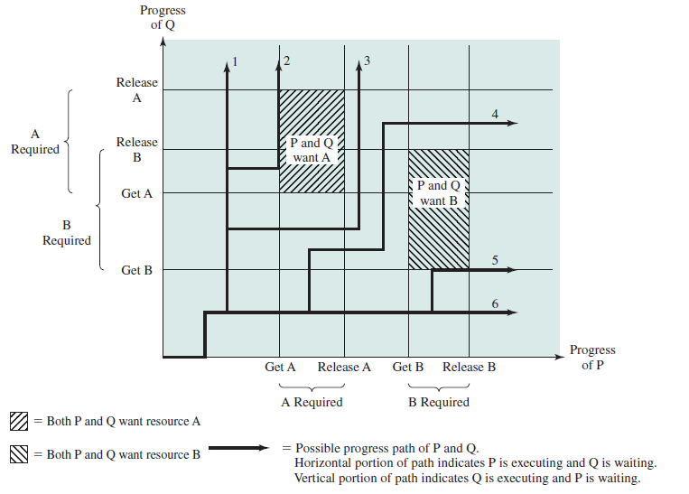
No Deadlock example (1)

Slide 11
No Deadlock example (2)
Process P Process Q
• • • • • •
Get A Get B
• • • • • •
Release A Get A
• • • • • •
Get B Release B
• • • • • •
Release B Release A
• • • • • •

Slide 12
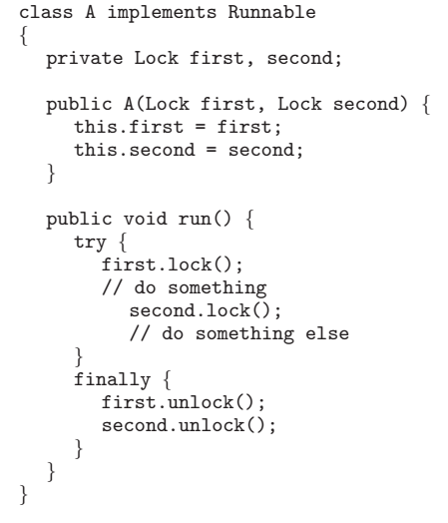
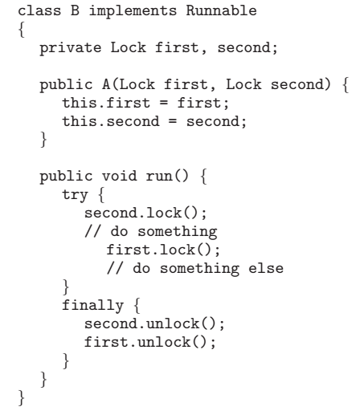
Deadlock Example
Operating Systems Concepts 8ed, Silberschatz, Galvin and Gagne

Slide 13
Condition for Resource Deadlock
Mutual exclusion: only one process at a time can use a resource.
Hold and wait: a process holding at least one resource is waiting to acquire additional resources held by other processes.
No preemption: a resource can be released only voluntarily by the process holding it, after that process has completed its task.
Circular wait: there exists a set {P0, P1, …, P0} of waiting processes such that P0 is waiting for a resource that is held by P1, P1 is waiting for a resource that is held by P2, …, Pn–1 is waiting for a resource that is held by Pn, and P0 is waiting for a resource that is held by P0.

Slide 14
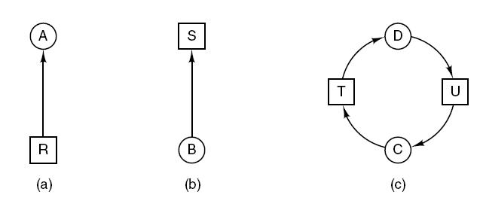
Deadlock Modeling (1)
Resource allocation graphs. (a) Holding a resource. (b) Requesting a resource. (c) Deadlock.

Slide 15
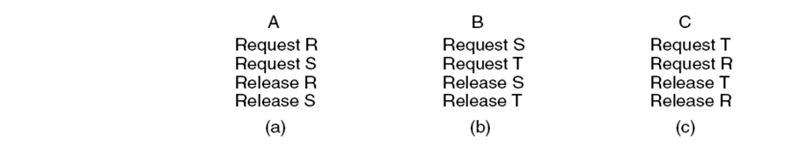
Deadlock Modeling (2)
If request come in the above order and the CPU processeds A, B and C in order → no deadlock but there is no parallelism

Slide 16
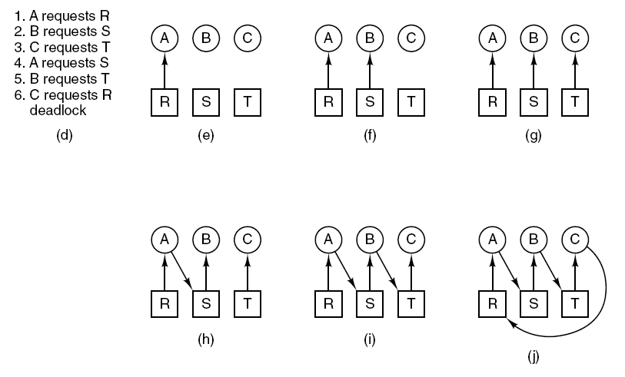
Deadlock Modeling (3)
If carried as in (d) → Deadlock

Slide 17
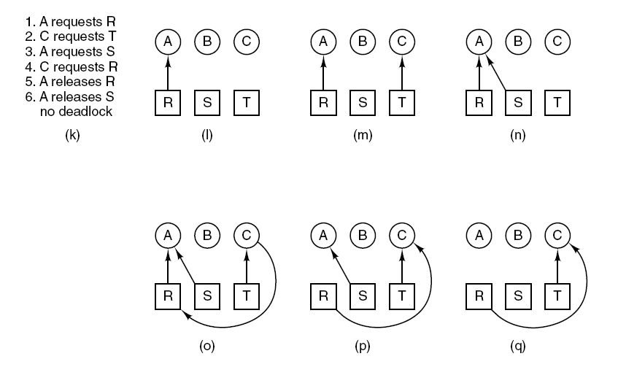
Deadlock Modeling (4)
An example of how deadlock occurs and how it can be avoided.

Slide 18
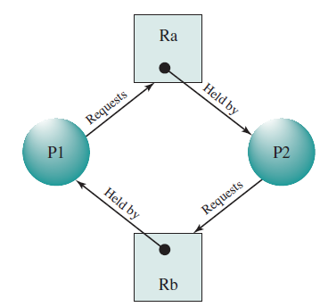
Example of deadlock using RAG

Slide 19
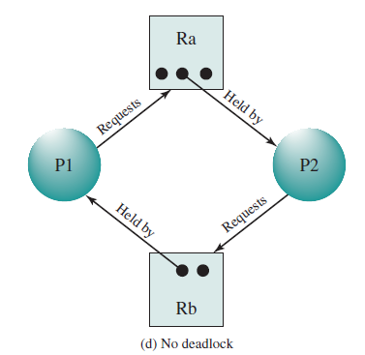
Example of no deadlock using RAG

Slide 20
Strategy dealing with Deadlock
Strategies for dealing with deadlocks:
Just ignore the problem. (Ostrich algorithm)
Detection and recovery. Let deadlocks occur, detect them, take action.
Dynamic avoidance by careful resource allocation.
Prevention, by structurally negating one of the four required conditions.

Slide 21
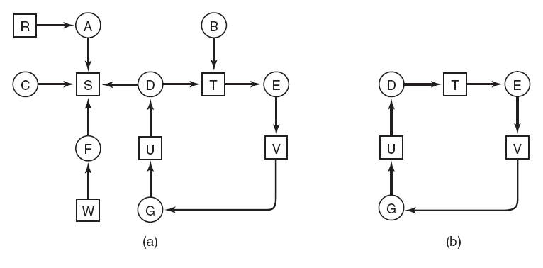
Deadlock Detection
(a) A resource graph. (b) A cycle extracted from (a).

Slide 22
Deadlock Avoidance
Requires that the system has some additional a priori information available.
Simplest and most useful model requires that each process declare the maximum number of resources of each type that it may need.
The deadlock-avoidance algorithm dynamically examines the resource-allocation state to ensure that there can never be a circular-wait condition.
Resource-allocation state is defined by the number of available and allocated resources, and the maximum demands of the processes.

Slide 23
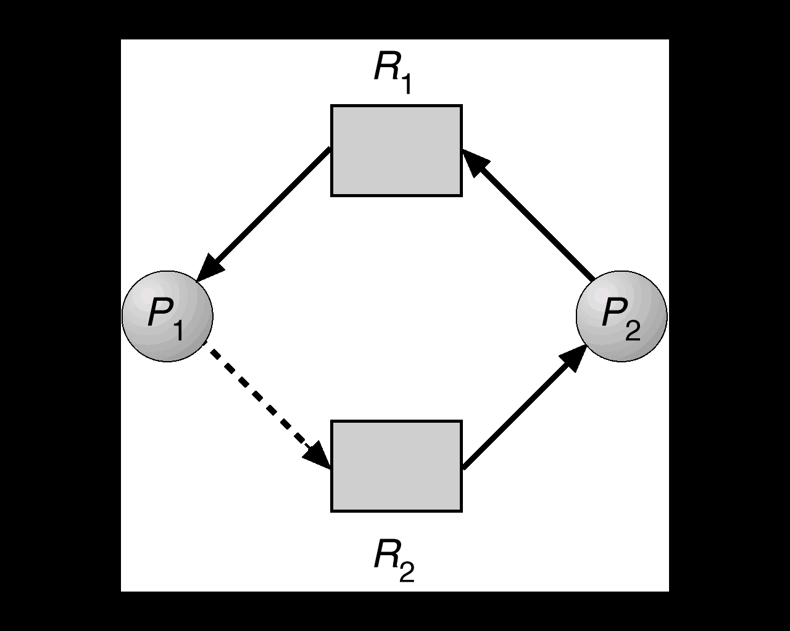
Deadlock Avoidance with RAG
Claim edge P_{i} → R_{j} indicated that process P_{j} may request resource R_{j}; represented by a dashed line.
Claim edge converts to request edge when a process requests a resource.
When a resource is released by a process, assignment edge reconverts to a claim edge.
Resources must be claimed a priori in the system.

Slide 24
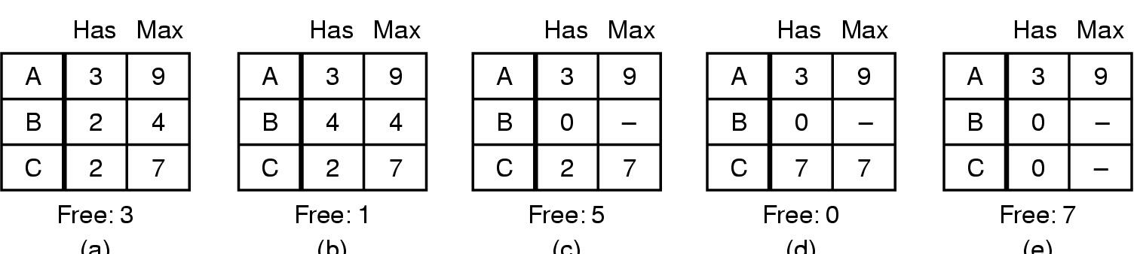
Safe and Unsafe state (1)
Demonstration that the state in (a) is safe

Slide 25
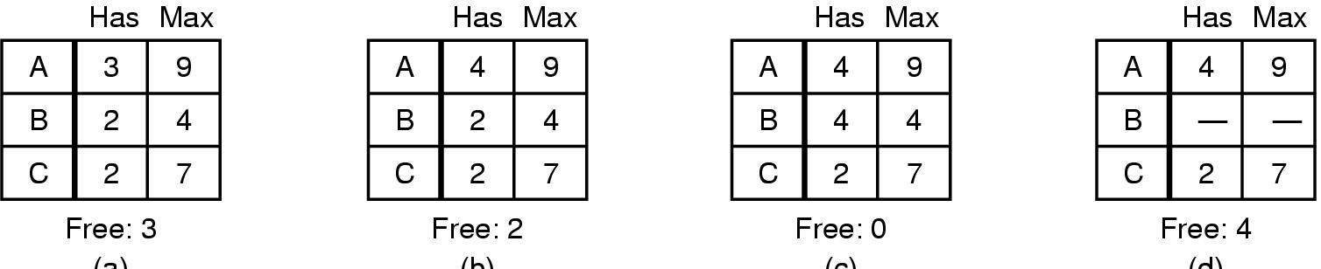
Safe and Unsafe state (2)
(a) (b) (c) (d)
Demonstration that the state in b is not safe

Slide 26
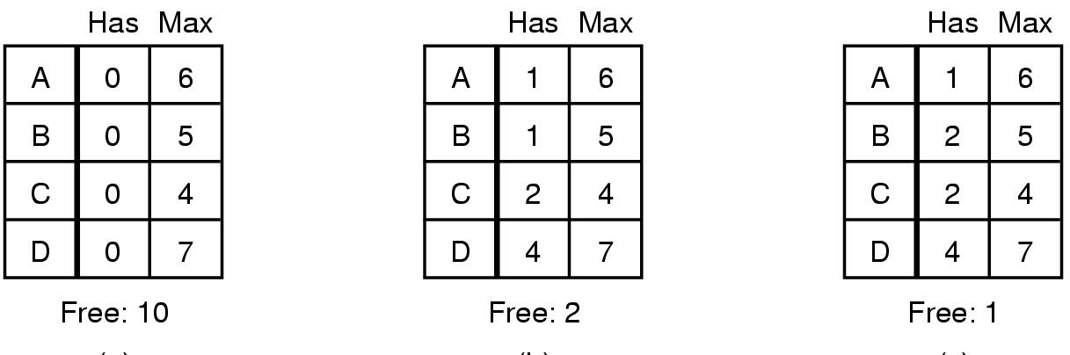
Banker’s Algorithm for single resource (deadlock avoidance)
(a) (b) (c)
Three resource allocation states
safe
safe
unsafe

Slide 27
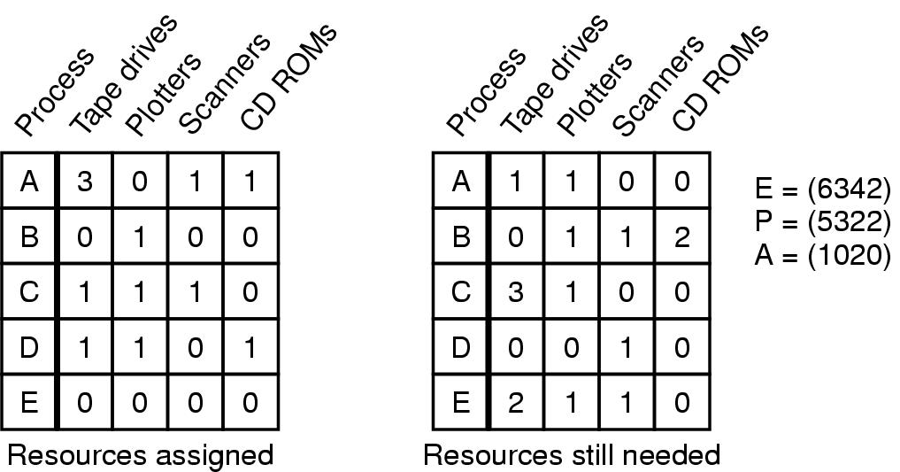
Banker’s Algorithm for multiple resources (deadlock avoidance)
Example of banker's algorithm with multiple resources

Slide 28
Deadlock Prevention (1)
Restrain the ways request can be made.
Mutual Exclusion – not required for sharable resources; must hold for nonsharable resources.
Hold and Wait – must guarantee that whenever a process requests a resource, it does not hold any other resources.
Require process to request and be allocated all its resources before it begins execution, or allow process to request resources only when the process has none.
Low resource utilization; starvation possible.

Slide 29
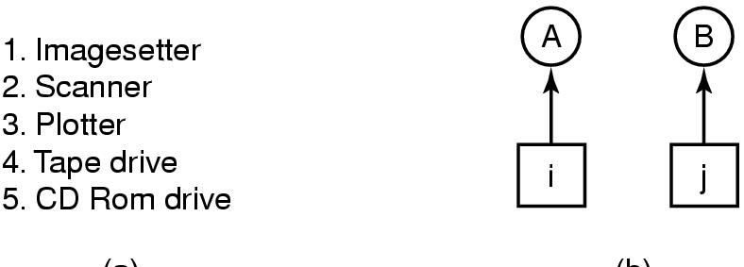
Deadlock Prevention (2)
Circular Wait
(a) Normally ordered resources
(b) A resource graph

Slide 30
Deadlock Prevention (3)
No Preemption
This is not a viable option
Consider a process given the printer
halfway through its job
now forcibly take away printer
!!??

Slide 31
Deadlock Recovery (Resource preemption)
Selecting a victim – minimize cost.
Rollback – return to some safe state, restart process for that state.
Starvation – same process may always be picked as victim, include number of rollback in cost factor.

Slide 32
References
Stallings, W. (2014). Operating Systems: Internals and Design Principles. 8^{th.} ISBN: 978-0-13-380591-8
A. Tanenbaum(2007), Modern Operating System, 3rd
ISBN: 978-0136006633
Abraham Silberschatz, Peter B. Galvin, Greg Gagne (2010). Operating System Concepts 8th ed. With Java
ISBN: 978-0-470-50949-4

